Slide 1
Web Applications

Slide 2
Goals
To understand the concept of a Web application
To learn the syntactic elements of JavaServer Faces(JSF)
To learn about navigation in JSF applications
To build three-tier web applications
JSP, JSF, and Servlets

Slide 3
Architecture of a Web Application
An application whose interface is displayed in a Web browser
The application interacts with a server in real time over the Internet
Stateful vs Stateless communications
  http is stateless – the server keeps no record of what it sent to any individual client
  The JSF may be thought of as "Swing for the Internet."
    It takes input and generates html to display output.
    Essentially a MVC design

Slide 4
A Simple JSF Program
JSF: Java Server Faces
To develop a JSF application, you need a web server that is integrated with a JSF container
A JSF page contains HTML and JSF tags
The user interface of a JSF application is described by a set of JSF pages

Slide 5
A Simple JSF Program
The structure has three parts:
  taglib directives required to locate two JSF libraries
    Tags from the core library have the prefix f: (such as f:view)
    Tags from the HTML library have the prefix h: (such as h:form)
    Items like f and h are namespaces
  All JSF tags must be contained inside an f:view tag
  The h:form tag encloses all user interface elements

Slide 6
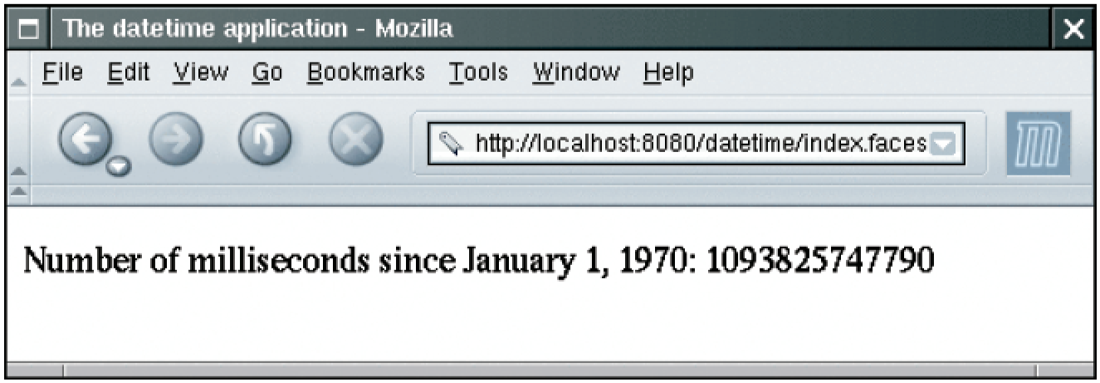
Executing the datetime Web Application

Slide 7
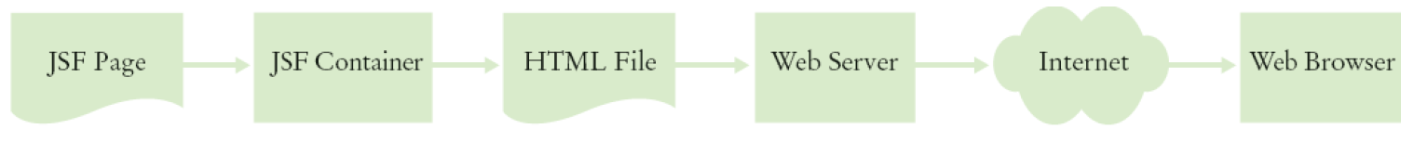
The JSF Container Rewrites the Requested Page

Slide 8
A Simple JSF Program
Purpose of a JSF page is to generate an HTML page
Basic process:
  HTML tags in the page are retained; they are the static part of the page
  JSF tags are translated into HTML; translation is dynamic, it depends on the state of Java objects
    The h: tags generate HTML
    The f: describe structural information that the h: tags use
  The taglib directives are stripped out

Slide 9
A Simple JSF Program
The JSF container converts a JSF page into an HTML page, replacing JSF tags with text and HTML
In the example, the h:outputText tag has the value binding #{dateTime.time}
Value bindings link JSF pages with Java objects
Continued

Slide 10
A Simple JSF Program
The Java objects are defined in a configuration file
  Named faces-config.xml
  Placed in the WEB-INF subdirectory of the web application's base directory

Slide 11
A Simple JSF Program
This file defines an object dateTime with type java.util.Date
A new object is constructed with each "request"
Whenever a browser requests the page,
  A new Date object is constructed, and
  It is attached to the dateTime variable
  The Date constructor constructs an object with the current time
Continued

Slide 12
A Simple JSF Program
#{dateTime.time} calls getTime of dateTime
The h:outputText tag converts the result of that method call to text

Slide 13
Important Design Principle of the JSF Technology
JSF enables the separation of presentation and business logic
Presentation logic: the user interface of the web application
Business logic: the part of the application that is independent of the visual presentation
JSF pages define the presentation logic
Java objects define the business logic
The value bindings tie the two together

Slide 14
Steps for Deploying a JSF Application
Make a subdirectory with the name of your web application in the webapps directory of your Tomcat installation
or
Place the index.jsp file into that directory
/usr/local/jakarta-tomcat/webapps/datetime
c:\Tomcat\webapps\datetime
Continued

Slide 15
Steps for Deploying a JSF Application
Create a subdirectory WEB-INF in your application directory
or
/usr/local/jakarta-tomcat/webapps/datetime
c:\Tomcat\webapps\datetime\WEB-INF

Slide 16
Steps for Deploying a JSF Application
Place faces-config.xml into the WEB-INF subdirectory
Place your Java classes (if any) inside
WEB-INF/classes
Place the file web.xml inside the WEB-INF subdirectory
Start the web server
Point your browser to http://localhost:8080/datetime/index.faces

Slide 17
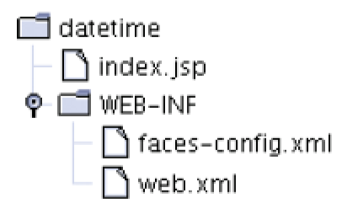
The Directory Structure of the datetime Application

Slide 18
JavaBeans Components
Software component:
  Encapsulates functionality
  Can be plugged into a software system without programming
  For example, the dateTime object
Unlike some programming languages, Java does have explicit support for components
Continued

Slide 19
JavaBeans Components
In Java, use a programming convention to implement components
  A JavaBean is a Java class that follows this convention
A JavaBean exposes properties–values of the component that can be accessed without programming

Slide 20
JavaBeans Components
JavaBean requirements:
  Must have a public constructor with no parameters
  Must have methods for accessing the component properties that follow the get/set naming convention

Slide 21
JavaBeans Components
For example, to get or set the time of a Date object, must use getTime and setTime
For a property with name propertyName and type Type,
Exception: the accessor of a boolean property can use an is prefix
public Type getPropertyName()
public void setPropertyName(Type newValue)
public boolean isShopping()

Slide 22
JavaBeans Components
The name of a property starts with a lowercase letter
The corresponding methods have an uppercase letter (isShopping)
Exception: property names can be all capitals (e.g. ID or URL)
  getID or setURL
Continued

Slide 23
JavaBeans Components
Read-only property: has only a get method
Write-only property: has only a set method
A JavaBean can have additional methods, but they are not connected with properties

Slide 24
JavaBeans Components
Many programmers follow the additional convention that the name of a bean class should end in Bean
The example bean has two properties: creditCard and shopping
Do not make any assumptions about the internal representation of properties
  May have an instance field for every property:
private String creditCard;
private boolean shopping;
Continued

Slide 25
JavaBean Scope
Request scope: the bean is available ONLY for the current request
Session scope: the bean is available for multiple requests by the same browser
Application scope: the bean stays alive for the entire web application
  It is shared among different users

Slide 26
JavaBeans Components
Access the bean properties in value bindings
Specify the name of the property, not the name of the get or set methods
  <h:inputText value="#{user.creditCard}"/>
  first calls getCreditCard
  When the user submits the form, the setCreditCard is called to store the edited property value
<h:outputText value="#{user.creditCard}"/>

Slide 27
JavaBeans Components:
An Example
We want to display the current time, not the number of milliseconds since January 1, 1970
Default time computation uses the time zone at the server location → not very useful
We will prompt for the city in which the user is located, and display the time in the user's time zone

Slide 28
JavaBeans Components:
An Example
Interaction with user:
  The user will simply enter the city name
  The time zone bean will replace the spaces in the name with underscores
  Then, check if that string appears at the end of one of the valid time zone IDs

Slide 29
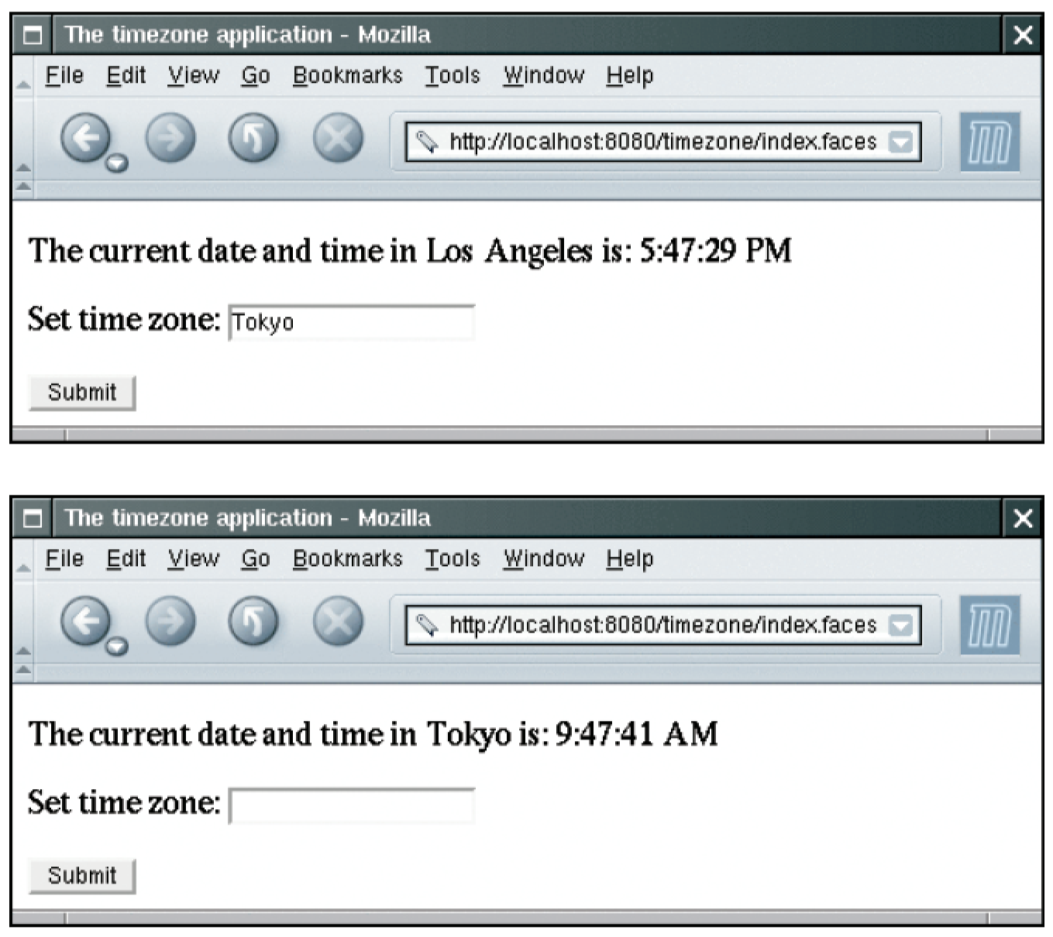
The timezone Application

Slide 30
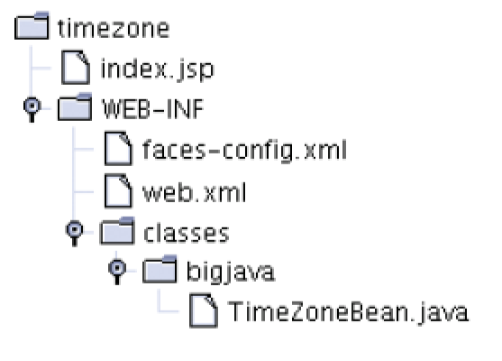
The Directory Structure of the timezone Application

Slide 31
JSF Components
Each component has a value attribute to connect the component value with a bean property
h:inputTextArea has attributes to specify
the rows and columns
<h:inputSecret value="#{user.password}"/>
<h:inputTextArea value="#{user.comment}"
rows="10" cols="40"/>

Slide 32
JSF Components
Radio button and checkbox groups allow you to specify horizontal or vertical layout:
<h:selectOneRadio value="#{burger.topping}"
layout="lineDirection">

Slide 33
JSF Components:
Button Groups and Menus
Require two properties:
  the collection of possible choices
  the actual choice
The value attribute specifies the actual choice to be displayed
The collection of possible choices is defined by a nested f:selectItems tag
<h:selectOneRadio value="#{creditCard.expirationMonth}"
layout="pageDirection">
<f:selectItems value="#{creditCard.monthChoices}"/>
</h:selectOneRadio>
Continued

Slide 34
JSF Components:
Button Groups and Menus
monthChoices must have a type that can
describe a list of choices
  For example, Map
  The keys of the map are the labels
  The corresponding map values are the label values

Slide 35
Example: Using a Map to Describe a List of Choices
The type of the value property of the component must match the type of the map value
  For example, creditCard.expirationMonth must be an integer
If multiple selections are allowed, the type of the value property must be a list or array of matching types

Slide 36
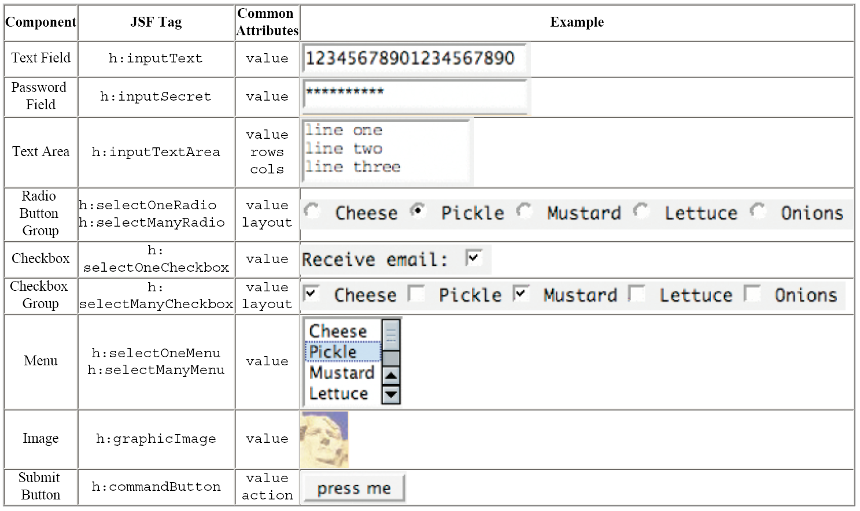
Common JSF Components

Slide 37
Navigation Between Pages
Consider an enhancement of our timezone program
We start with a page that prompts the user to enter the name of a city
When the user clicks "Submit" a new page appears
Continued

Slide 38
Navigation Between Pages
Next page is either the page with the time display or an error page if no time zone is available
The JSF container needs to determine which page to show next

Slide 39
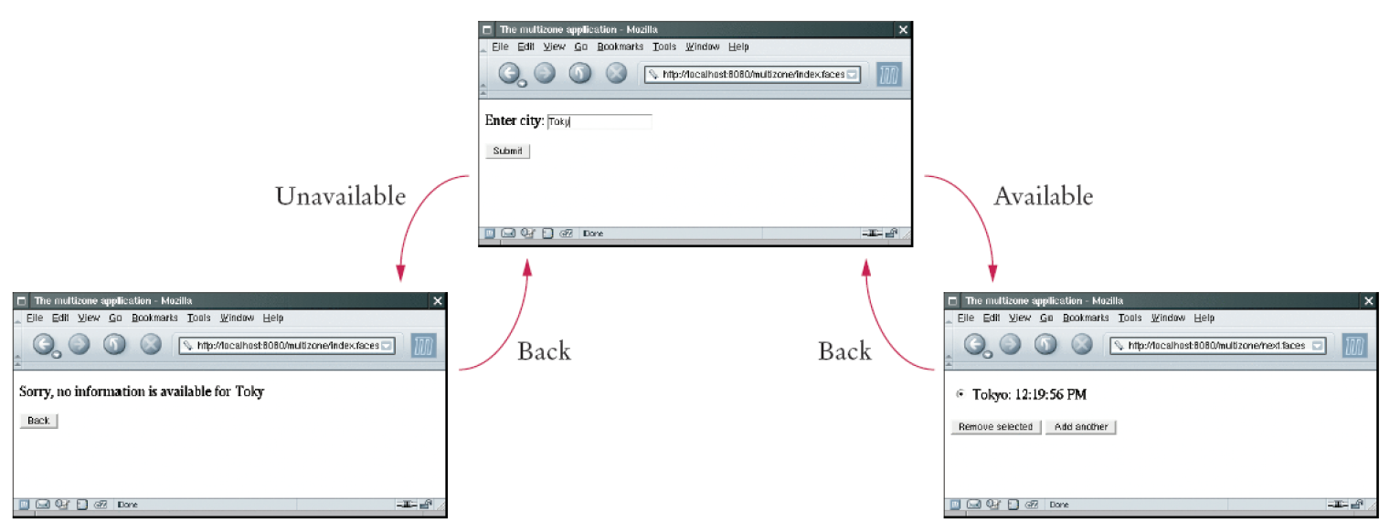
Navigating Between Pages

Slide 40
Navigation Between Pages
Each button has an outcome, a string used to look up the next page
Generally, next page may depend on the result of some computation
We need different outcomes depending on the city entered
Continued

Slide 41
Navigation Between Pages
Specify a method binding as the action attribute:
A method binding consists of the name of a bean and the name of a method
<h:commandButton value="Submit" action="#{zone.addCity}"/>

Slide 42
Navigation Between Pages
If next page doesn't depend on a computation, you set the action attribute of the button to a fixed outcome string
<h:commandButton value="Back" action="back"/>

Slide 43
Navigation Between Pages
Current page is redisplayed when
  The button has no action attribute, or
  The action outcome is not listed in the navigation rules

Slide 44
A Three-Tier Application
A three-tier application has separate tiers for presentation, business logic, and data storage
  The presentation tier: the web browser
  The "business logic" tier: the JSF container, the JSF pages, and the JavaBeans
  The storage tier: the database

Slide 45
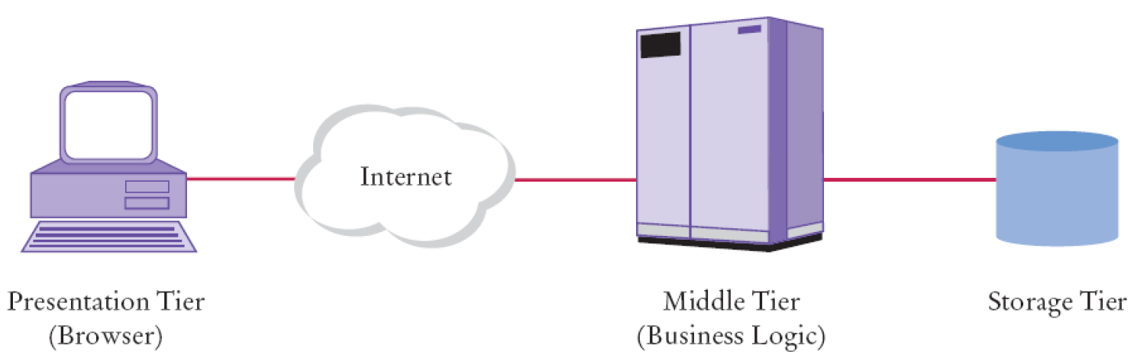
Three-Tier Architecture

Slide 46
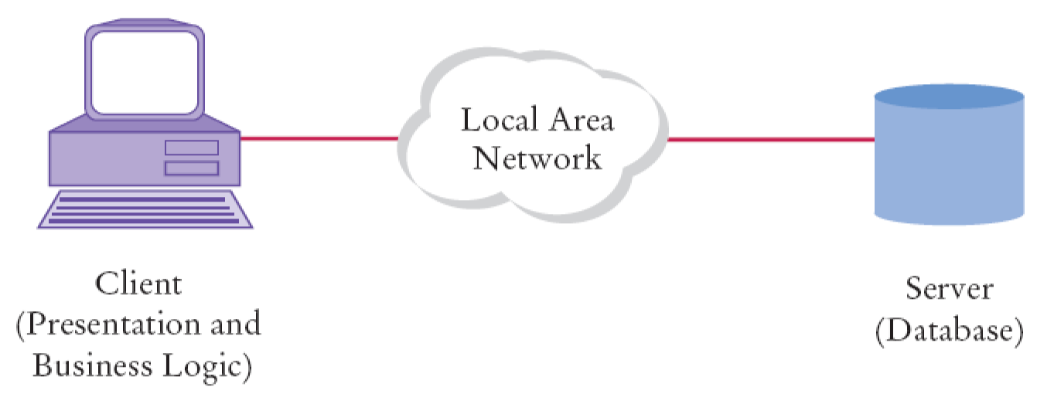
Two-Tier Client-Server Architecture

Slide 47
A Three-Tier Application
A Three-Tier Application
If business logic changes
  In a two-tier application, new client program must be distributed over all desktops
  In a three-tier application, server code is updated, while presentation tier remains unchanged
    Simpler to manage

Slide 48
A Three-Tier Application
We will have a single database table, CityZone, with city and time zone names
If the TimeZoneBean can't find the city among the standard time zone IDs, it makes a query:
If there is a matching entry in the database, that time zone is returned
SELECT Zone FROM CityZone WHERE City = the requested city

Slide 49
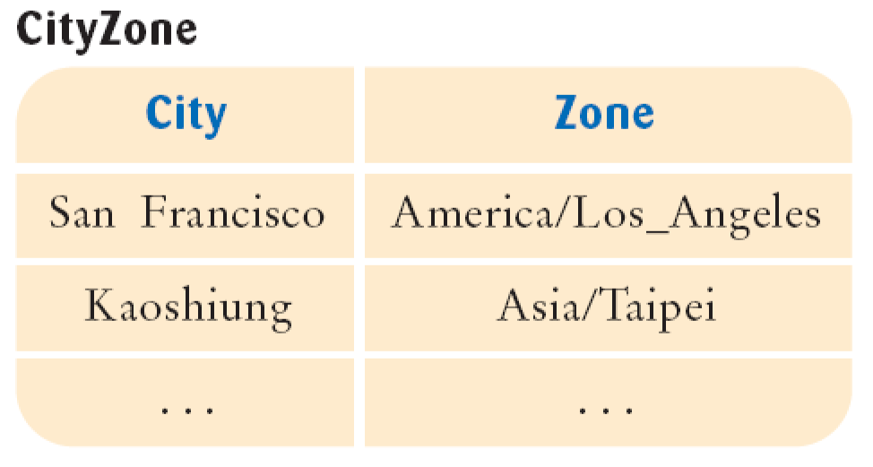
The cityZone Table
Figure 12:
The cityZone Table

Slide 50
A Three-Tier Application
To query the database, the bean needs a Connection object
With Tomcat, specify the database configuration in conf/server.xml
  Locate the element
  Immediately after, add the configuration information found on the next slide
  You need to place the JDBC driver file into common/lib
  Restart server after changing the configuration file
<Host name="localhost" . . . >

Slide 51
A Three-Tier Application
JSF containers such as Tomcat manage a pool of database connections
  Pooling avoids the overhead of creating new database connections
  Pooling is completely automatic

Slide 52
A Three-Tier Application
Enhanced TimeZoneBean so that it manages a list of cities
Can add cities to the list and remove a selected city
Continued

Slide 53
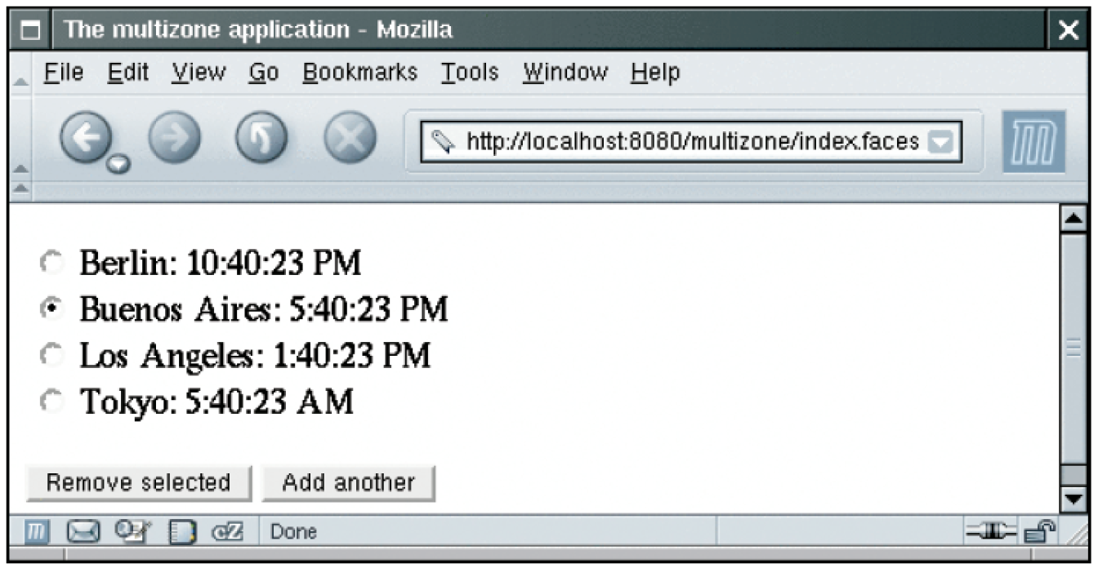
A Three-Tier Application

Slide 54
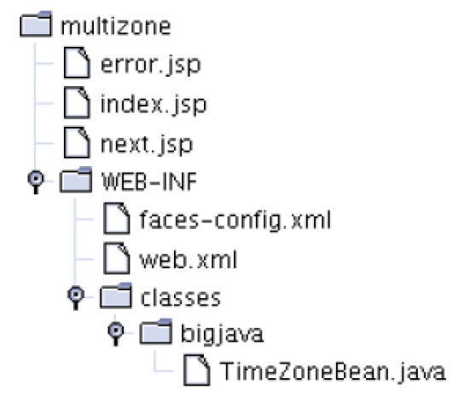
The Directory Structure of the multizone Application

